Slide 1

Name:
Arash Harirpoosh
Student Number:
9731505
Presentation Title:
RFID Specs

Slide 2
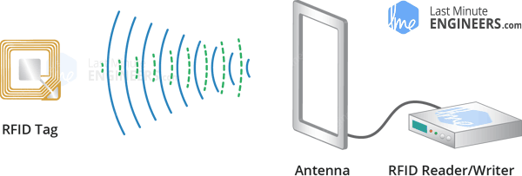
RFID Components
Consists of two main components:
Transponder/tag attached to an object to be identified
Transceiver also know as interrogator/Reader
A Reader in RFID Module:
Consists of a Radio Frequency Module which generates high frequency electromagnetic field
Tag in RFID Module
Is a passive device, means that it doesn’t contain a battery
Contains microchip that stores and processes information, then the antenna receive and transmit a signal

Slide 3

How Does RFID’s Work?
What happens Inside RFID Module:
Reader generates electromagnetic field which causes electrons to move through the tag’s antenna and subsequently power the chip
Powered chip inside the tag then responds by sending its stored information back to the reader in the form of another radio signal. (This is called backscatter)
Change in the electromagnetic/RF wave or the backscatter, is detected and interpreted by the reader which sends the data out to a computer or microcontroller

Slide 4
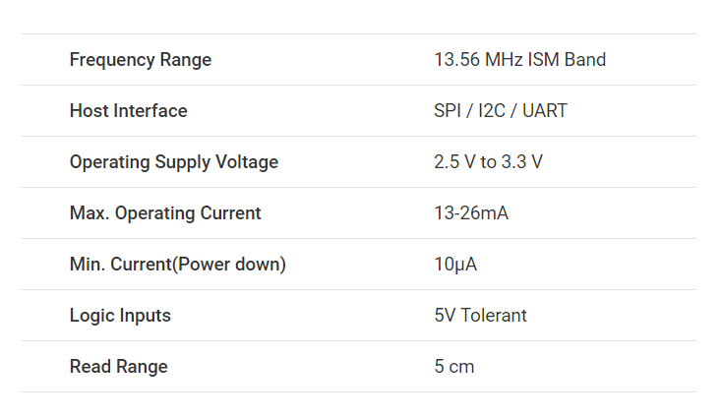
RFID Hardware Overview
Tag
Have 1 KB memory
Can store some sort of secrete messages by writing it in a tag
Reader
Create 13.56 MHz electromagnetic field
Communicate with a microcontroller over a 4—pin SPI with a maximum data rate of 10Mbps
Supports communication over I2C and UART protocols
Operating voltage of the module is from 2.5 to 3.3 V

Slide 5
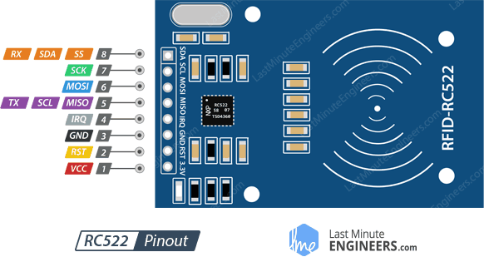
RFID Module Pinout
VCC
Supplies power for the module. This can be anywhere from 2.5 to 3.3 volts
RST
Input for Reset an power-down
When goes low, hard power-down is enabled, that turns off all internal current sinks including the oscillator and the input pins are disconnected from the outside world.
On the rising edge, the module is reset

Slide 6
RFID Module Pinout
GND
Ground Pin
IRQ
interrupt pin that can alert the microcontroller when RFID tag comes into its vicinity
MISO / SCL / Tx
Acts as Master-In-Slave-Out when SPI interface is enabled
Acts as serial clock when I2C interface is enabled
Acts as serial data output when UART interface is enabled

Slide 7
RFID Module Pinout
MOSI (Master Out Slave In)
SPI input to the RC522 module
SCK (Serial Clock)
Accepts clock pulses provided by the SPI bus Master
SS / SDA / Rx
Acts as Signal input when SPI interface is enabled
Acts as serial data when I2C interface is enabled
Acts as serial data input when UART interface is enabled
It can be used as a reference for identifying the other pins

Slide 8
References
https://lastminuteengineers.com/how-rfid-works-rc522-arduino-tutorial/#:~:text=RFID%20or%20Radio%20Frequency%20Identification,generates%20high%20frequency%20electromagnetic%20field.

